Slide 1


Exploring Bitcoin And Cryptocurrency Market

Slide 2


TEAMS MEMBERS
NAME | ROLL NO
VIJAY VARDHAN M | 20211IST0019
SUDIKSHA.N | 20211IST0016
D P RAKSHITHA | 20211IST0007

Slide 3
INTRODUCTION:
The cryptocurrency market, particularly Bitcoin, is a complex and dynamic system that presents both opportunities and risks for investors.
In this report, we present an analysis of Bitcoin price data using Python programming language.
The analysis includes predicting future prices, assessing volatility, and evaluating market sentiment using various machine learning models and techniques.
Notes:
Let’s consider a simple example:
we collect historical Bitcoin prices over the past year.
By analyzing this data, we look for patterns and trends.
Using tools like machine learning, we can predict future prices based on past behavior.
We visualize this data with easy-to-understand charts and graphs. These visualizations help us see trends and make predictions more clearly.
In this session, we'll show you how we gather data, analyze it, and create visual predictions.
By the end, you'll see how these methods can help you make better investment decisions.

Slide 4
DATA USED:
The data used in this project is gathered from Wikipedia for sentiment analysis, and Yahoo finance for Bitcoin prices over the years.

Slide 5
METHODOLOGY USED
1.Random Forest Classifier: is an ensemble learning method primarily used for classification tasks. It builds multiple decision trees during training and merges them to get a more accurate and stable prediction.
How It Works:
Decision Trees
Bootstrap Aggregating (Bagging):
Random Feature Selection
Majority Voting
Advantages:
Robustness
Accuracy
Notes:
RandomForestClassifier
Overview: RandomForestClassifier is an ensemble learning method primarily used for classification tasks. It builds multiple decision trees during training and merges them to get a more accurate and stable prediction.
How It Works:
Decision Trees: A Random Forest is composed of numerous decision trees. Each tree is trained on a random subset of the data and features.
Bootstrap Aggregating (Bagging): It uses a technique called bagging, where each tree is trained on a random sample of the training data (with replacement).
Random Feature Selection: During the training of each tree, a random subset of features is selected to split each node, which helps in making the model robust and reducing overfitting.
Majority Voting: For classification, the Random Forest algorithm aggregates the votes from different decision trees to decide the final class of the test object.
Advantages:
Robustness: Due to the combination of multiple trees, the model is less likely to overfit compared to a single decision tree.
Accuracy: It generally provides high accuracy for classification tasks due to the averaging of multiple decision trees.

Slide 6
METHODOLOGY USED
XGBClassifier: is part of the XGBoost library, which stands for Extreme Gradient Boosting. It is a powerful machine learning algorithm used for supervised learning tasks, including classification and regression.
How It Works:
Gradient Boosting Framework:
Boosting
Regularization
Efficiency
Advantages:
Performance
Flexibility
Handling Complexity
Notes:
Overview: XGBClassifier is part of the XGBoost library, which stands for Extreme Gradient Boosting. It is a powerful machine learning algorithm used for supervised learning tasks, including classification and regression.
How It Works:
Gradient Boosting Framework: XGBoost is based on the gradient boosting framework, which builds an ensemble of trees sequentially. Each new tree tries to correct the errors made by the previous trees.
Boosting: Unlike RandomForest which builds trees independently, XGBoost builds trees one at a time, where each subsequent tree focuses on reducing the errors (residuals) of the previous tree.
Regularization: XGBoost includes regularization parameters to control the complexity of the model, which helps in preventing overfitting.
Efficiency: It is optimized for speed and performance, using advanced techniques like parallel processing, tree pruning, and handling of missing values.
Advantages:
Performance: XGBoost is known for its high performance and accuracy, often outperforming other algorithms in machine learning competitions.
Flexibility: It supports various objective functions and evaluation metrics, making it suitable for a wide range of tasks.
Handling Complexity: It can handle complex patterns in the data due to its advanced tree boosting methods.

Slide 7
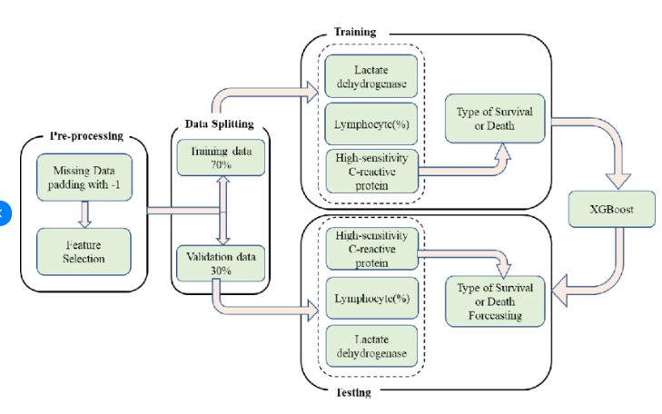
FLOWCHART OF METHODOLOGY
XGB Classifier

Slide 8
LIMITATIONS:
Data Quality and Feature Selection
Non-Stationarity
Lack of Causality
Overfitting
Model interpretability

Slide 9
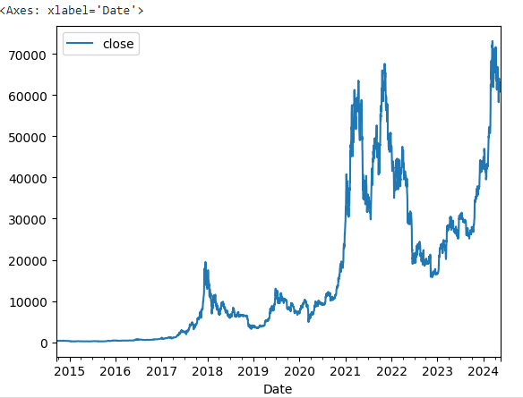
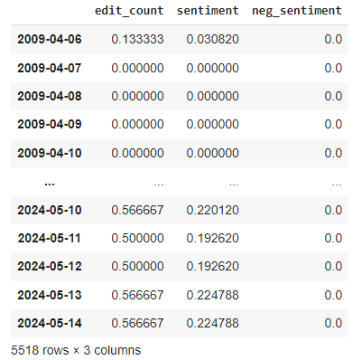
RESULT

Slide 10
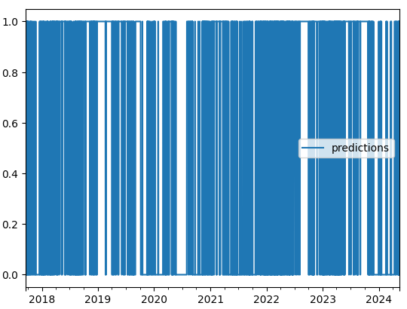
RESULT

Slide 11

CONCLUSION
Using data analysis and machine learning techniques for Bitcoin price prediction can provide valuable insights, but it's essential to acknowledge the limitations. While models like Decision Trees (such as RandomForestClassifier) and Gradient Boosting (like XGBClassifier) can offer predictive power, factors like data quality, market dynamics, and model interpretability significantly impact their effectiveness. Therefore, while these approaches can be informative, they should be used cautiously, supplemented with domain expertise, and considered alongside other analytical methods for a comprehensive understanding of Bitcoin price movements.

Slide 12

THANK YOU !!!

